Slide 1
Your EHR: Is it making you more money? Or costing you time and opportunity?
R
Randy Torban
Senior Practice Analyst
Symplast EHR

Slide 2
Randy Torban
Randy has spent the past 15 years identifying, creating, and enhancing workflows, identifying raw data trends and translating them into actionable KPIs for retail and health care companies of all sizes. ​
Randy currently serves as Senior Practice Analyst for Symplast, the mobile EHR/practice management platform designed specifically for plastic surgery and medical spas. With a focus on maximizing the patient's experience, Randy regularly presents best practices to help medical business owners increase revenue and enhance the patient experience.​

Slide 3
Agenda
Common Terminology
Technology’s Impact
Feature Focus
Online Booking
Digital Forms
Capacity
Before & After’s
Encounter Notes
Loyalty
Inventory Management
Measuring our Performance
Return on Investment

Slide 4
Commonly Used Terminology
EHR
An Electronic Health Record (EHR) is a digital clinical record.
CRM
Customer Relationship Management (CRM) is tracking leads and opportunities, not EHR. CRM tools can range from Hubspot and SalesForce, to specific, industry-focused tools like MedicalPRM, MyMedLeads, AD Vital, etc.
EMR
An Electronic Medical Record (EMR) focuses solely on the digital chart/encounter.
KPI
Key Performance Indicators (KPIs), are quantifiable metrics used to track and gauge business performance.
PM
Practice Management (PM) Software includes the administrative tools of a practice such as online booking with payment, patient throughput, before/after photos and reporting
ROI
ROI is your Return on Investment, and your KPIs can help show you the ROI (or not) of the changes you make.
POS
Point of Sale (POS) refers to the financial tracking of the practice: who sold what for how much and to who. Inclusive of treatment plans, estimates, packages and loyalty.

Slide 5
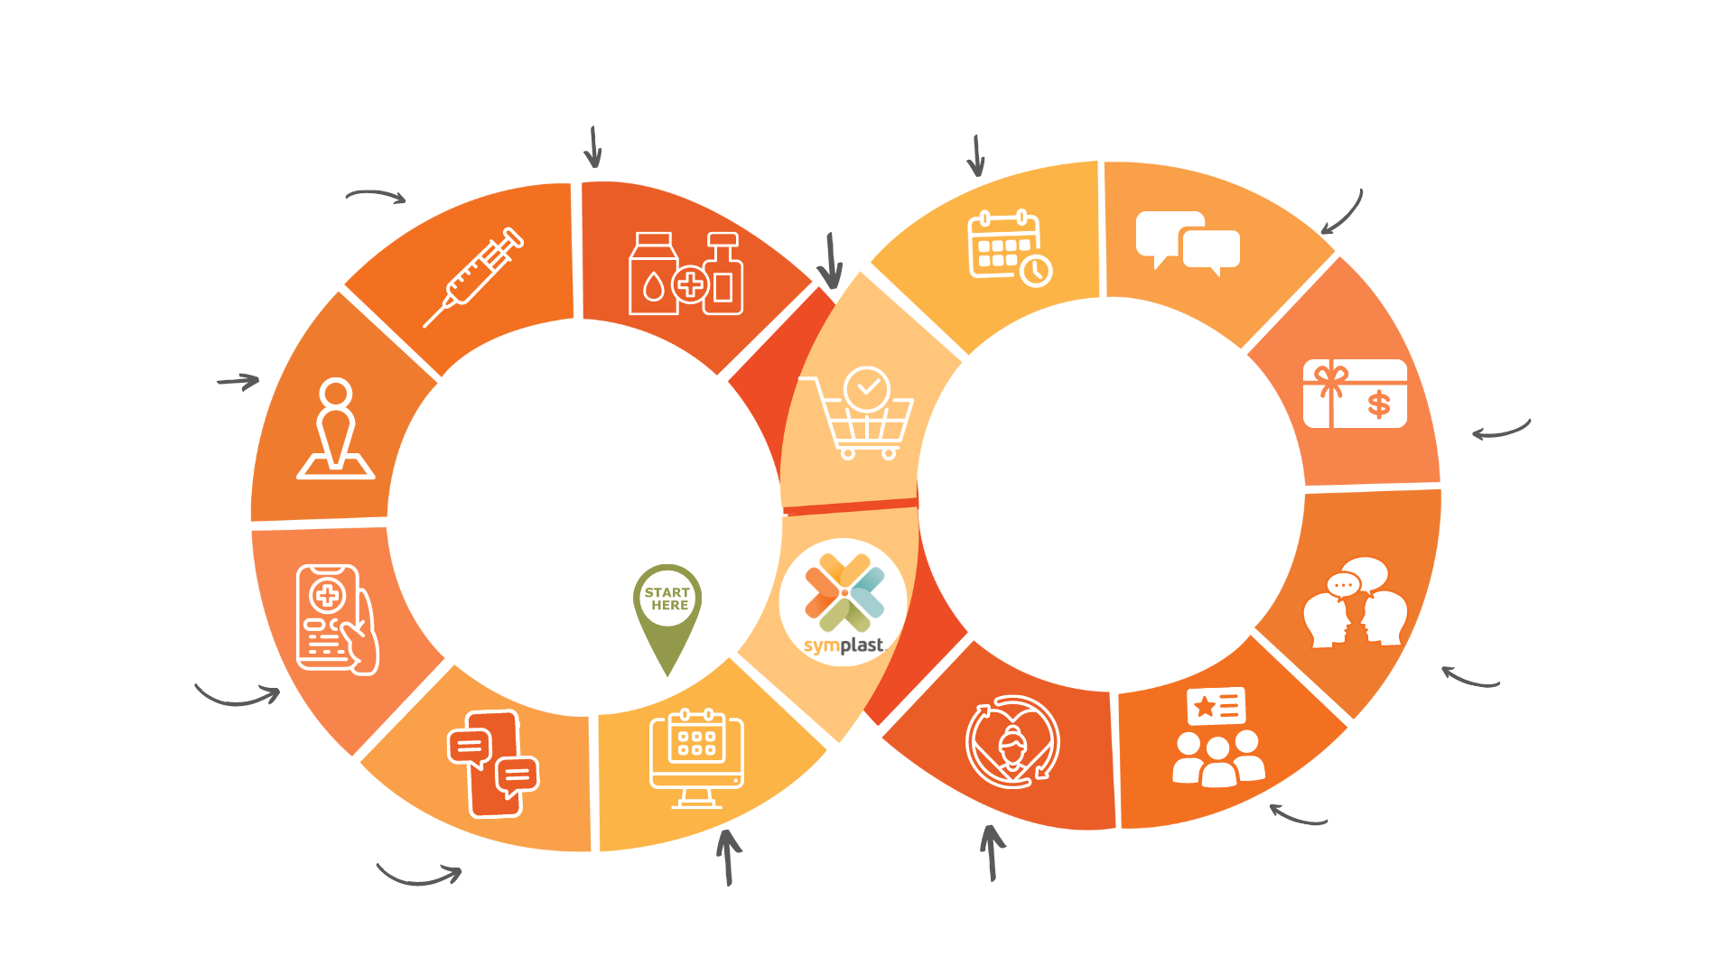
Technology's impact on the Patient Journey
Within the patient journey there are numerous products and services that treat the patient’s goal, not just a specific service type.
Today's patient is expecting automated appointment reminders, access to medical records, the ability to communicate directly with their providers, to know the communication is secure
How do you both meet your patient’s expectations while improving your business?
Rebook Next
Appointment
Cross Sell
Maintain Communication
Patient Receives Treatment
Patient Checks In
Offer Referral Promotions
Fill Out
Paperwork Online
Patient Talks About Their Visits to Others
They Leave You a Glowing 5-Star Review
Pre-Appointment
Communication
Book Online
Loyal, Return Patient
Notes:
Well, today using Mintimeter, as we review workflows and patient experiences, you my audience can vote on what you do – and you’ll be able to see how you stack up to your peers…

Slide 6
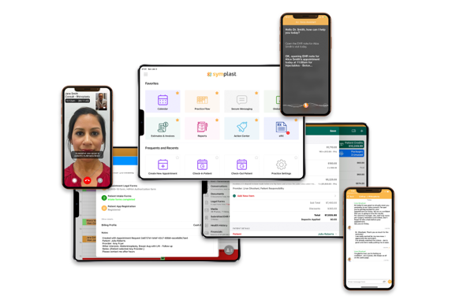
The Features That Will Make or Break Today’s Aesthetic Practice
The wrong tools create a lackluster presentation for your patients that negatively impact an aesthetic business’ ability to turn that patient into a lifelong advocate
Every aesthetic practice needs the right tools to grow and exceed the industry average of 283 visits a month
Every aesthetic practice should be reaching and exceeding the industry average of $536 per visit
The right comprehensive platform provides the industry- specific tools that balance both retail and healthcare functionality
Finally, the right platform creates the right harmony between providing a great patient experience and the need of a provider’s work-life balance

Slide 7
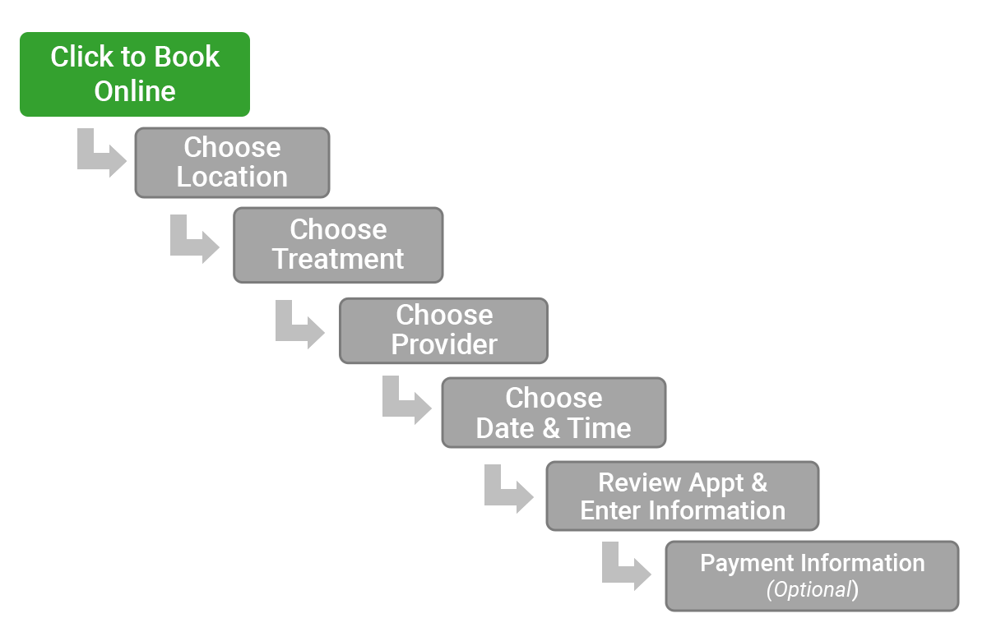
Online Booking, Phone Booking, or both?
Patient expectation is to easily book from a computer or mobile device. Fill your calendar while you sleep and on your patient's time:
Provides availability, the choice of service and providers
Lower overhead on staff
Charge fees by appointment type
Patients choose who to book with
Add additional services
Would- be concerns like no show rate, patients booking wrong appointments are alleviated by:
Confirmations – a text and/or email message to confirm the appointment details
Reminders – text and/or emails that ensure the patient arrives and isn't late or a no show
Paperwork – a text and/or email link to digital intake forms to complete pre-appointment

Slide 8
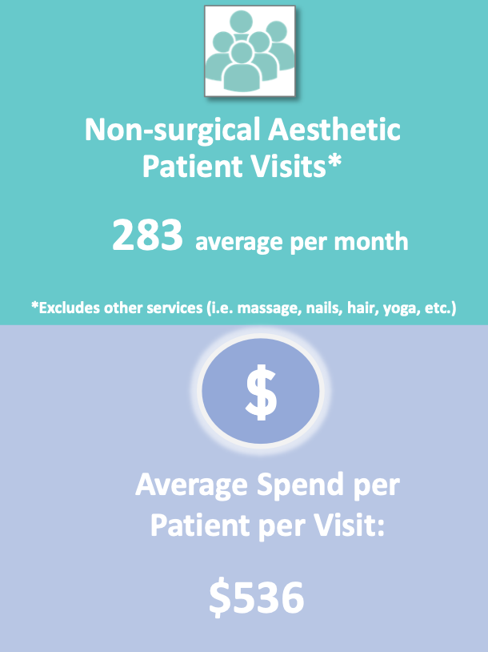
Industry Averages - Where Do You Land?
Questions for audience:
How does your business compare to the industry averages?
Do you allow patients to book online?
What % of your patients book online ?

Slide 9
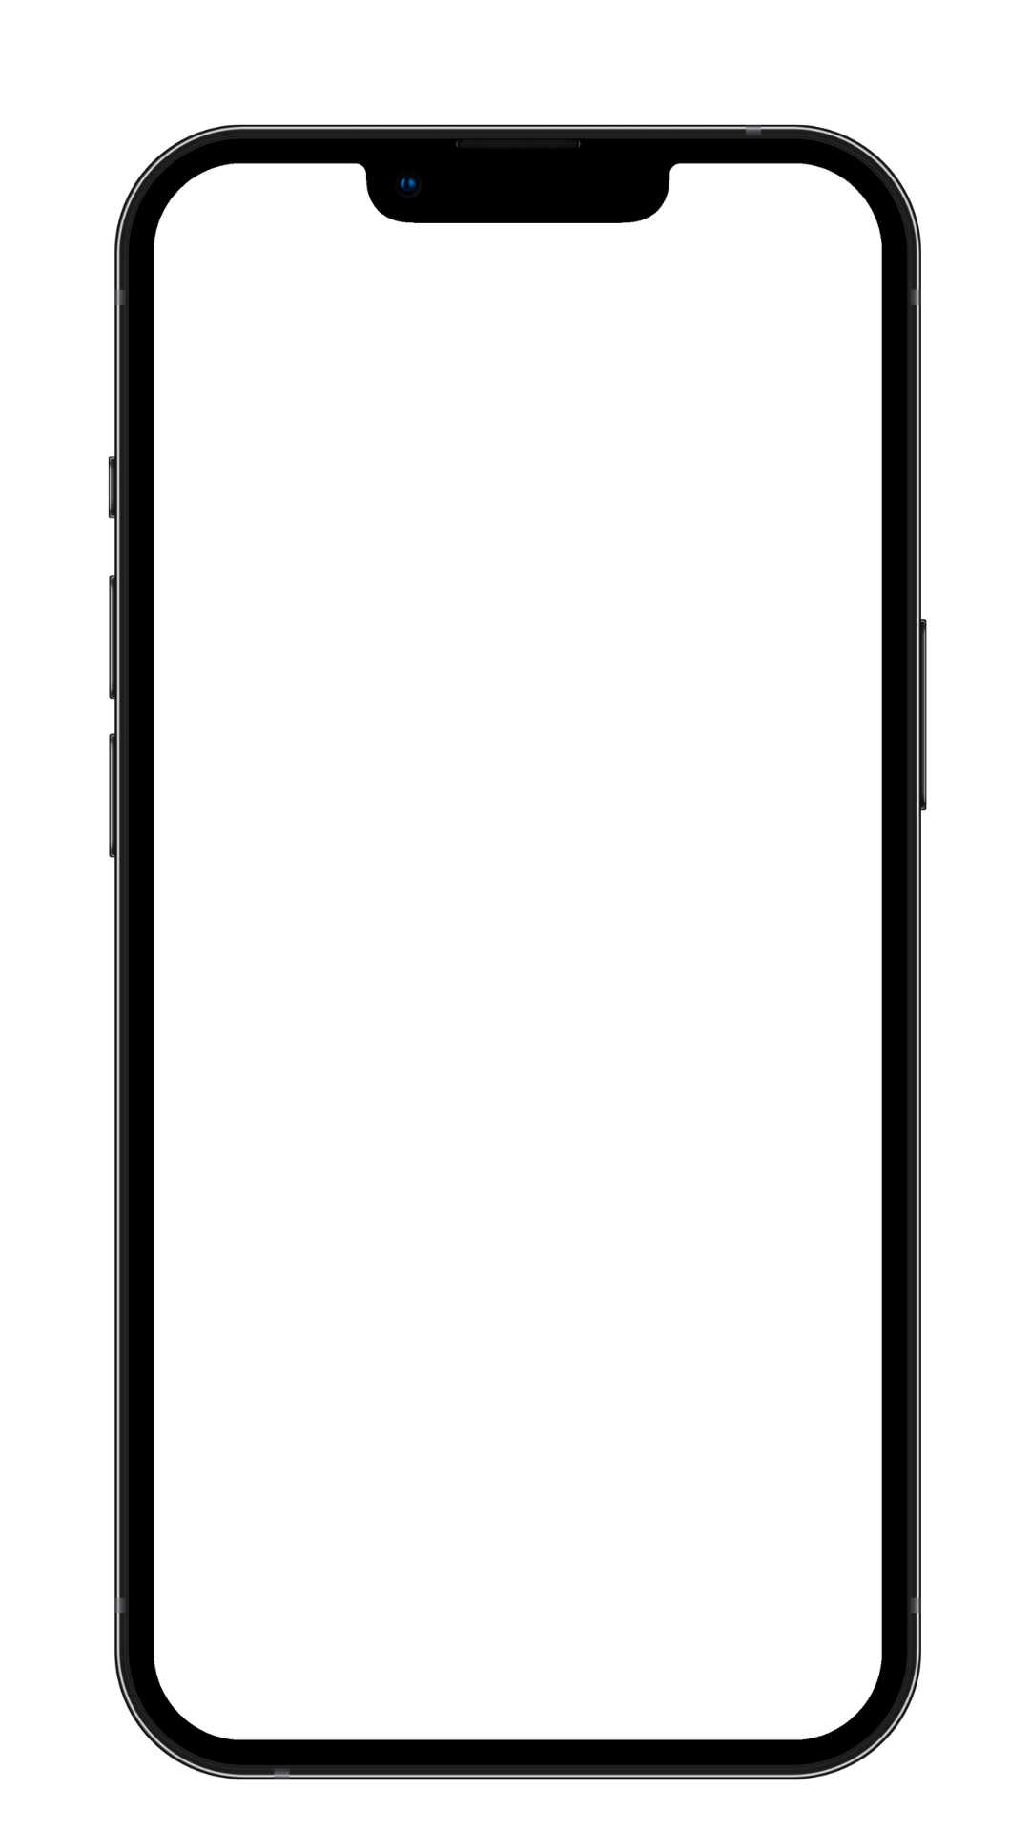
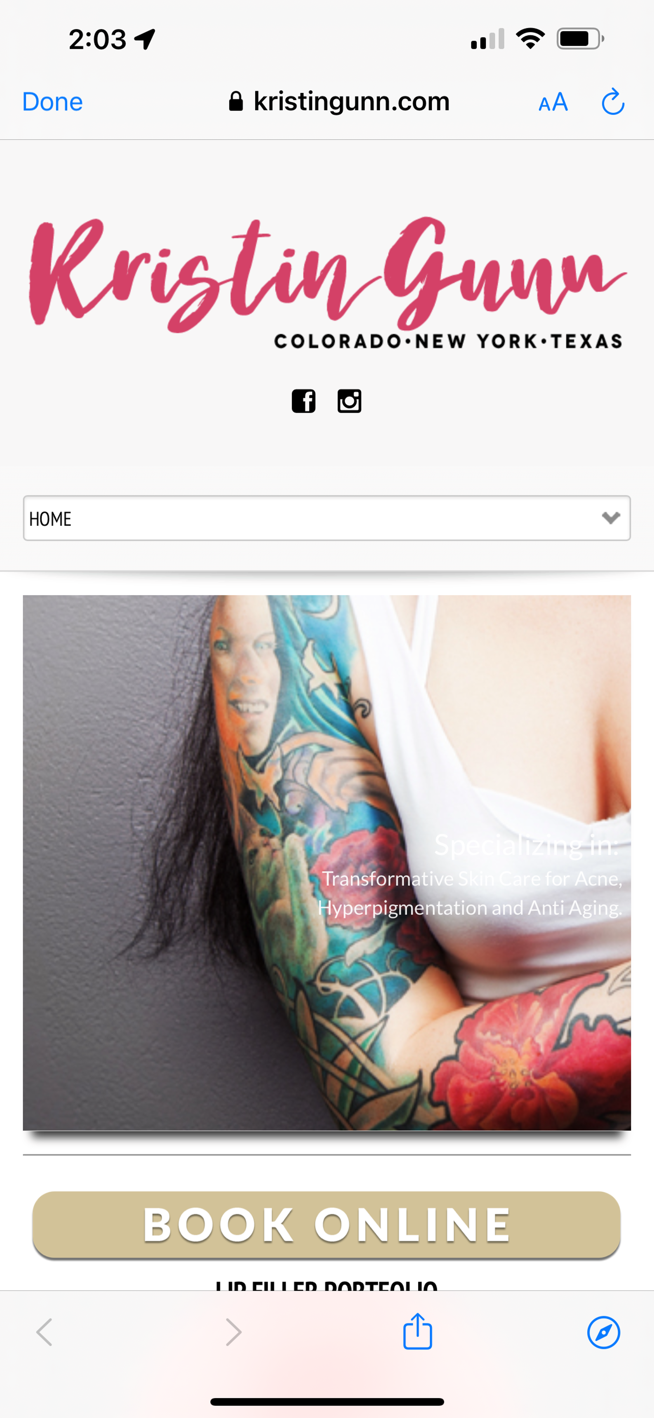
Better ROI With Online Booking
Industry average is 283/month or about 3,400 visits a year. A single Symplast Med Spa generated 5,500+ appointments online this past year Online booking help practices realize growth without additional cost:
If it takes your front desk 10 minutes to book an appointment, even at 6 appointments/ day that means offline booking is costing you an hour a day- time that can be used for an additional 2 appointments or $1,000+ in visits
Meanwhile, by offering online booking you can take appointments while closed while patients can book appointments on their time - even just 1 more appt a day delivers $500+
Improving your capacity to see more patients and making the patient booking experience easier can net an additional $1,500+ per day without additional overhead
Notes:
https://www.americanspa.com/sponsored/6-ways-online-booking-saves-you-time-and-money
On average it takes approximately 10 minutes for the front desk to book an appointment. Manually booking 5000 appointments a year, evenly across 365 days, means your offline booking process requires approximately 2 1/2 hours a day – or 833.3 hours a year - in employee labour alone. This time could be put to better use on other tasks, like guest services and upselling.
Online booking eliminates the need for phone calls.
Meanwhile, online booking allows you to literally make money while you sleep, as nearly 10% of bookings are made when the spa is closed e.g. 10% of 14 appointments a day at $150 each means you could make $54,600 a year. This is revenue you’re not going to recoup. If someone wants to book an appointment at 10 pm and you’re not answering the phone, they’re going to find someone who offers online booking. Can you afford to lose 10% of your revenue?
12:07

Slide 10
Digitizing Your Patient Forms
Without Technology
Technology Enhanced
Patient complete forms on site or are emailed PDF forms to print and return
Paper forms are added to the patient's file and/or need to be digitized manually
Rifle through paper files to confirm what forms go with which encounter
Staff resources wasted double-entering in patient details
After reviewing an incredible website, how do patients perceive being handed a clipboard and having to add their cell/email address for the 10th time?
Staff confirm other paper files to provide to patients or fax such as lab orders
Patients can complete forms remotely and/or on an iPad at the practice​
Forms automatically upload into patient's digital file ​
Patients have a smooth digital experience for all additional forms to be completed during the encounter
Forms all time and date stamped/organized by each encounter automatically​
Labs and orders can be digitally submitted and/or shared with patients to submit themselves​
No double entry for staff; no lack of morale due to busy work and the focus can be on patients not paperwork

Slide 11
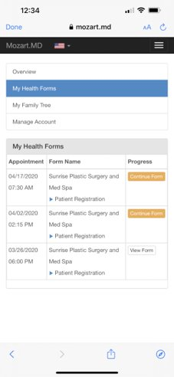
Mobile Forms Are a Must
Do you still use clipboards in your practice?
If it takes your front desk 10 minutes to scan in and file a physical form, that means that is costing an hour a day in employee labor alone
By using digital forms staff are free to focus on the patient experience. Meanwhile staff can upsell and cross sell treatment plans
Increasing your average invoice by simply upselling one ($50) product every other appointment (about 150 appts) can generate over $7,500+ a month

Slide 12
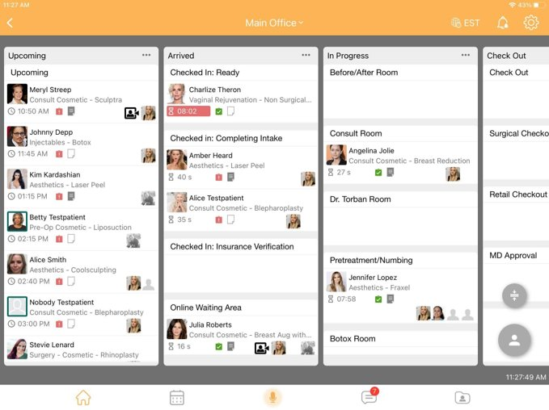
Improving Efficiency
How are you ensuring that you are maximizing your time?
How long do patients wait for service and how long are they in for service?
A new patient appointment takes longer than an existing patient for that same service- are you tracking them differently?
The right PM tool helps maximize capacity by:
Track the real vs ideal times
Ensure waiting time doesn't get too high – could impact review
Capacity drives revenue

Slide 13
Efficiency + Capacity Management = $$$
How long does an existing patient Botox appointment at your business take?
Practice A
Practice B
Practice A takes 25-30 minutes per existing patient Botox appointment
This practice can treat 2 patients per hour
Practice A generates 2 x $536 = $1,000+ an hour
Practice B takes 15-20 minutes per existing patient Botox appointment
This practice can treat 3 patients per hour
Practice B generates 3 x $536 = $1,500+ an hour
Even if practice A increases their prices by 10%, they are still not reaching the same revenue opportunity per day
Practice B can offer competitive pricing without any additional cost to their patients by maximizing their capacity with the right tool

Slide 14
Before & After’s
1 in 4 patients cite Before & After photos as the most influential content when selecting a Doctor for a procedure/ treatment.
Capturing and presenting media to your patients, sharing with them electronically AND posting to social media is as simple as:
Capture your patient’s photo
Document & present your treatment plan
Easily share the media

Slide 15
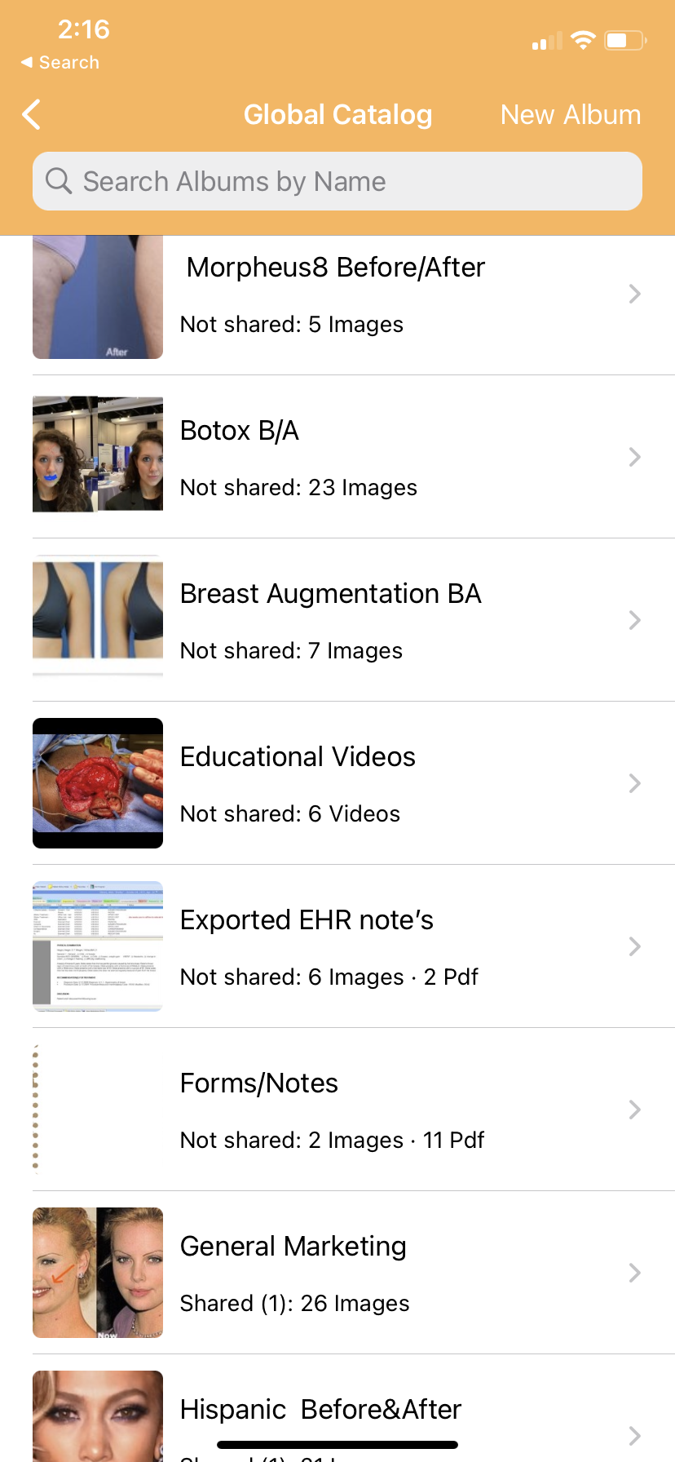
Leveraging Media to Improve Conversion
How regularly are you recording media and using it to promote your services?
49% of patients cite social media having a direct influence on their consideration or decision to have a cosmetic procedure
81% of patients want to see media that resembles them
It’ vital to be able to catalog and organize media by age/ demographic for quick recall showing your patients results that can reflect their outcome

Slide 16
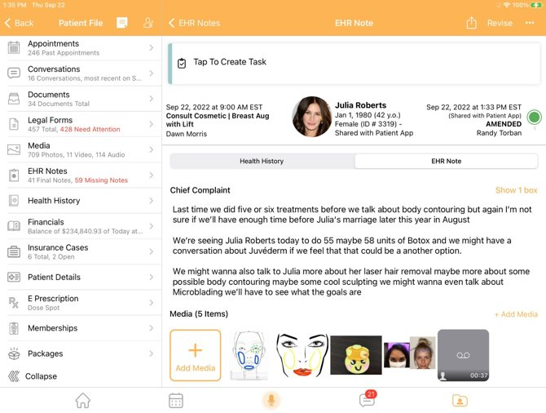
Compliant Documentation
Proper documentation & review clinical details:
Confirm the medical director's "sign-off" and approval of a mid-level's chart and/or order
Review of past encounter notes along with health history
Quickly and accurately document treatments through typing, voice dictation, audio notes and templates
Combine clinical text with media
Share documentation (upon request)
Prescribing medications
Create and submit e-prescriptions

Slide 17
Encounter Notes – The Presentation Continues
Beyond voice dictation
Beyond drawing on media
The ability to capture documentation while staying completely engaged with your patient Without costing you time and capacity

Slide 18
Guarantee The Next Appointment With Loyalty
Gift Cards
Brand Loyalty Programs
Turn 1 appointment into 2; save 1-and-done's; lower the barrier of entry when introducing additional products and services.
Alle and Aspire programs promote patient's product purchases and can add to your revenue stream. Through integration, usage and reconciliation of brand loyalty points can easily be managed.
Packages
Memberships
Create custom treatment plans that involve multiple sessions and combine multiple services/products. Allow patients to pay through installments and/or provide a discount for paying up front. Provide value to your patients and create loyalty to prevents your patient from enticing Groupon offers.
Move beyond finite loyalty programs and provide patients with membership options that are billed monthly, quarterly, yearly etc. Create tiers that meet the different price points of your market; provide different membership programs that include monthly discounts or a "bank" program in which patients can receive monthly credit to use on anything.

Slide 19
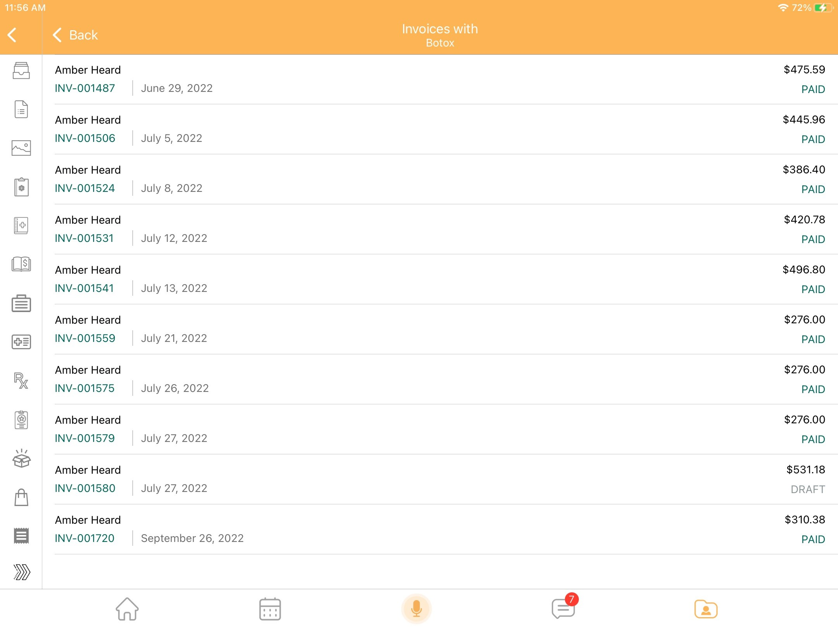
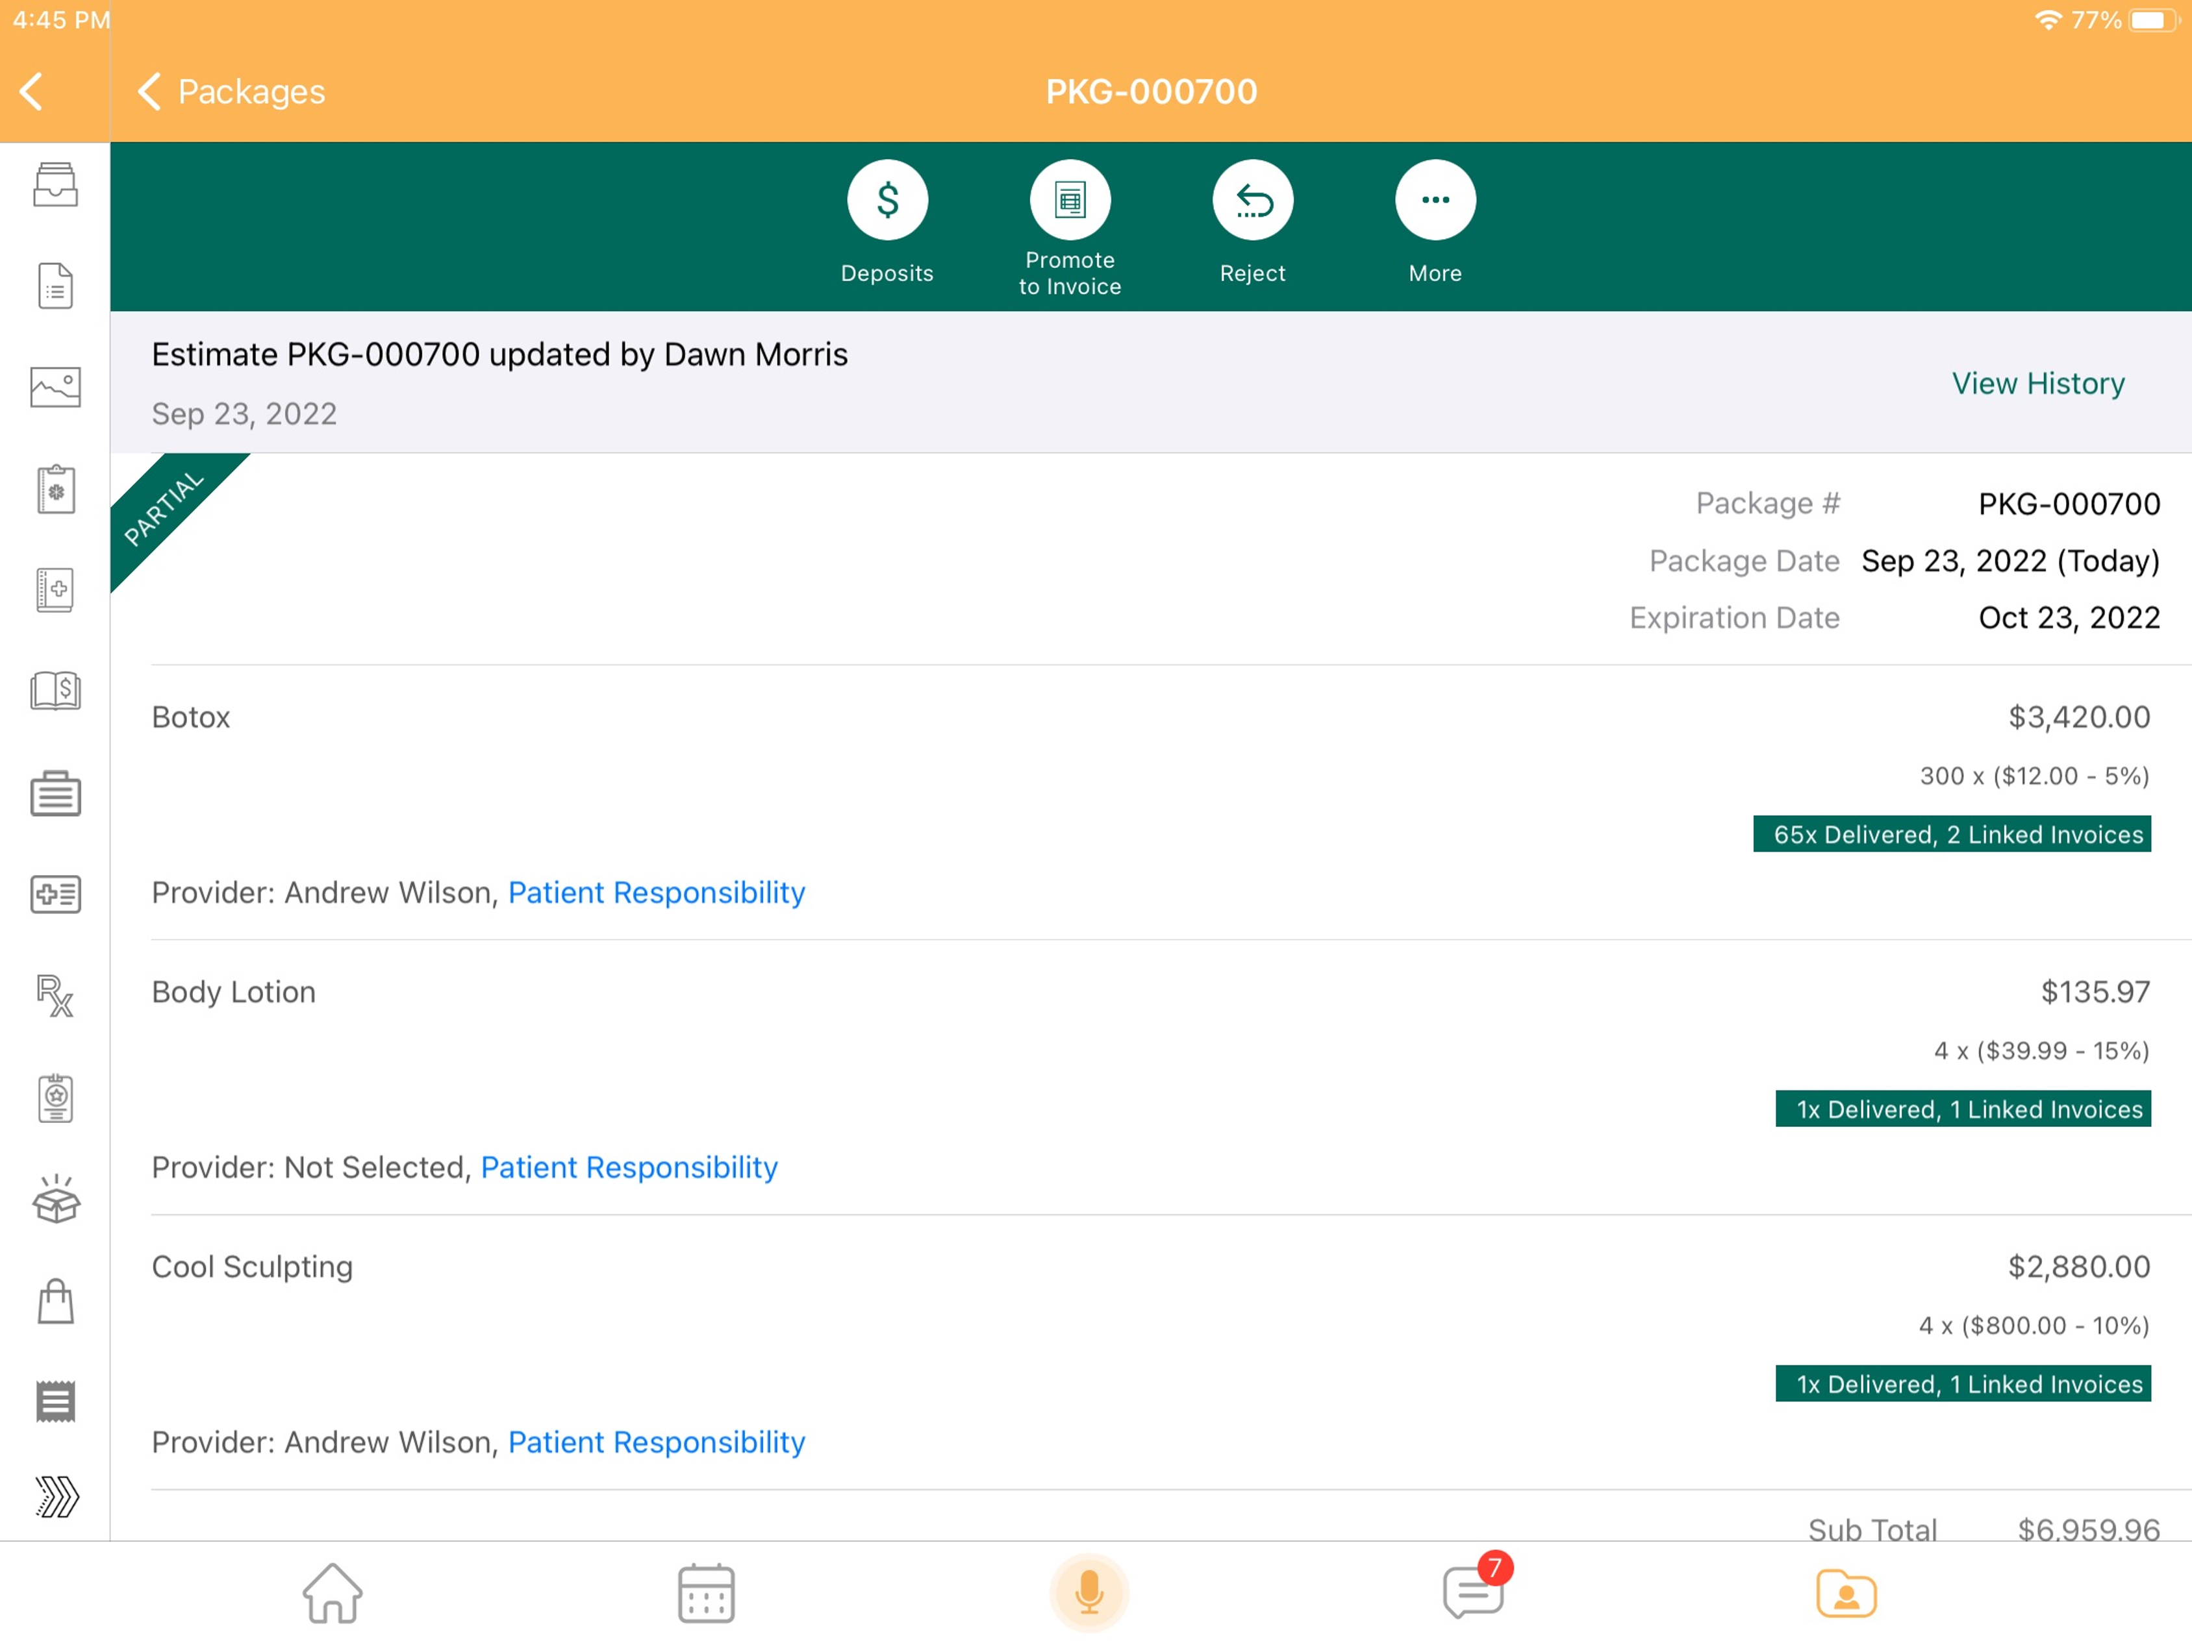
How Many Patients
Do Not Return?
What % of patients leave your business with a treatment plan or a loyalty program?
Confirm payment status
Who sold the package (or portions of it)
How much of each section has been utilized
Different discounts per line item
Track and view all invoices associated with each line item
On average, 65% of patients repeat visits. By implementing a loyalty program or treatment plan, increasing that percent of repeat patients by just 10% could net an additional 340 visits per year!
Notes:
Example of a package that shows multiple line times, different discounts etc.

Slide 20
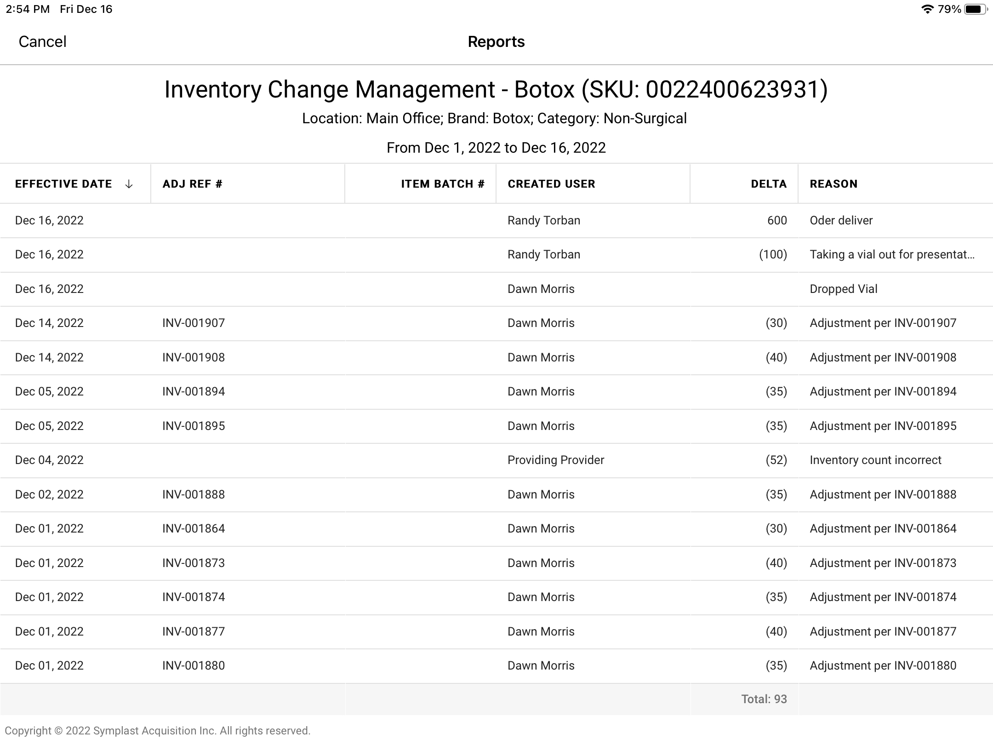
Tracking Inventory is Key
Inventory counts with updates
Notate incoming inventory
Identify Missing/broken inventory
Track Inventory transfers – between locations and business units
All inventory movement by User for oversight and accountability
Inventory alerts when running low on stock
Know your item and disposable utilization for future orders to lower your cost

Slide 21
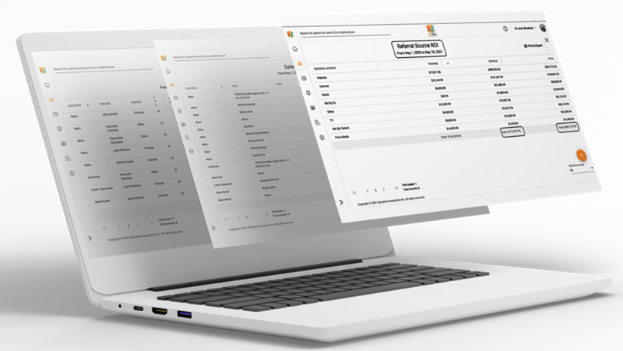
Measuring our Performance
Sales by various dimensions…
Sales by item and service
But by gross and new sales totals to see most popular/profitable items and services
By provider/staff: Who is your top performer and earner? What’s the delta between them and your next best?
By patient: What patients are your biggest spenders? Offer them loyalty or let your marketing team target them in campaigns
Appointment details
What are your outcomes? Some would ask “what is your conversion rate?”
What is your ratio of online bookings to your phone?
Do you need another front desk person? Add more overhead?
Review a User Audit report to track everything staff is doing (right and wrong)

Slide 22
Return on Investment
More appointments per hour ……………………………………………………………. | 5%
Increase revenue per invoice ……………………………………………………………. | 5%
Decreasing costs of goods sold ………………………………………………………. | 5%
Selling more items/services with higher margins …………………………. | 5%
Providing every patient with a 1, 3, 5+ year treatment plan …………. | 5%
More reoccurring patient appointments + new patient appointments | 5%
Add up the above = | 30% increase!
Notes:
All of these things we’ve reviewed are workflows taking place today. And it’s because technology (when it works) is here to add efficiency but not at the cost of service. Presentation is key in our industry and your EHR is an investment – a strategy in the managing of your patient. The strategies goals are two-fold to both provide you the business owner a greater sense of control as well as provide your patients with a great experience… one that keeps them coming back and telling their friends about you.

Slide 23
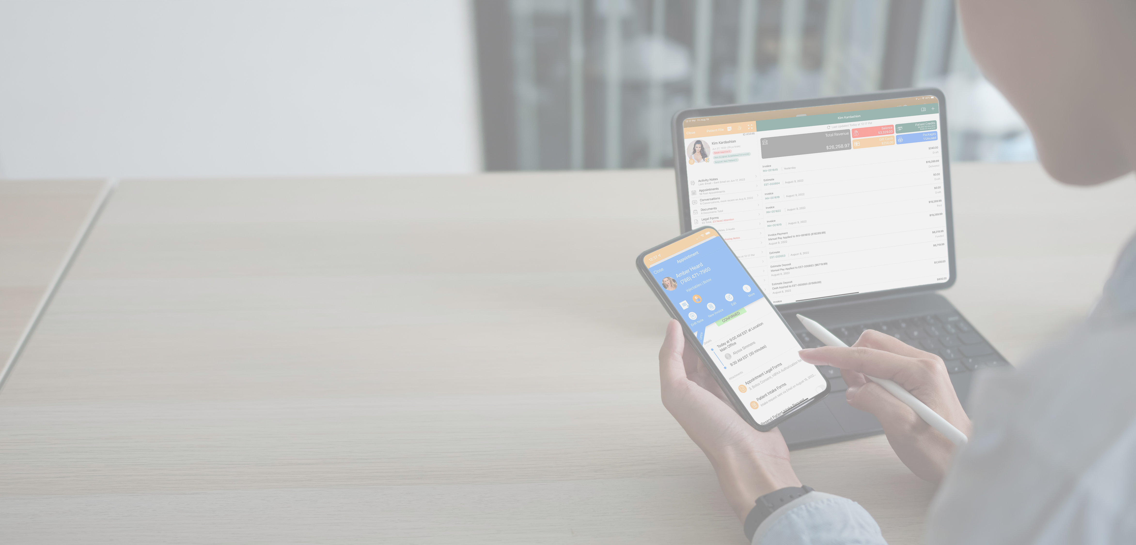
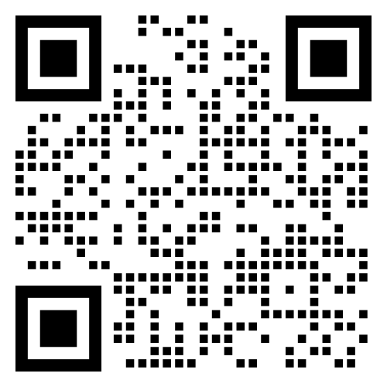
THANK YOU!
Randy Torban
Senior Practice Analyst
rtorban@Symplast.com
844-796-7527
Symplast.com
Notes:
All of these things we’ve reviewed are workflows taking place today. And it’s because technology (when it works) is here to add efficiency but not at the cost of service. Presentation is key in our industry and your EHR is an investment – a strategy in the managing of your patient. The strategies goals are two-fold to both provide you the business owner a greater sense of control as well as provide your patients with a great experience… one that keeps them coming back and telling their friends about you.

